Slide 1

MentoBliss
Guiding Minds, Empowering Lives
Mental Stress Detection
and Care

Slide 2
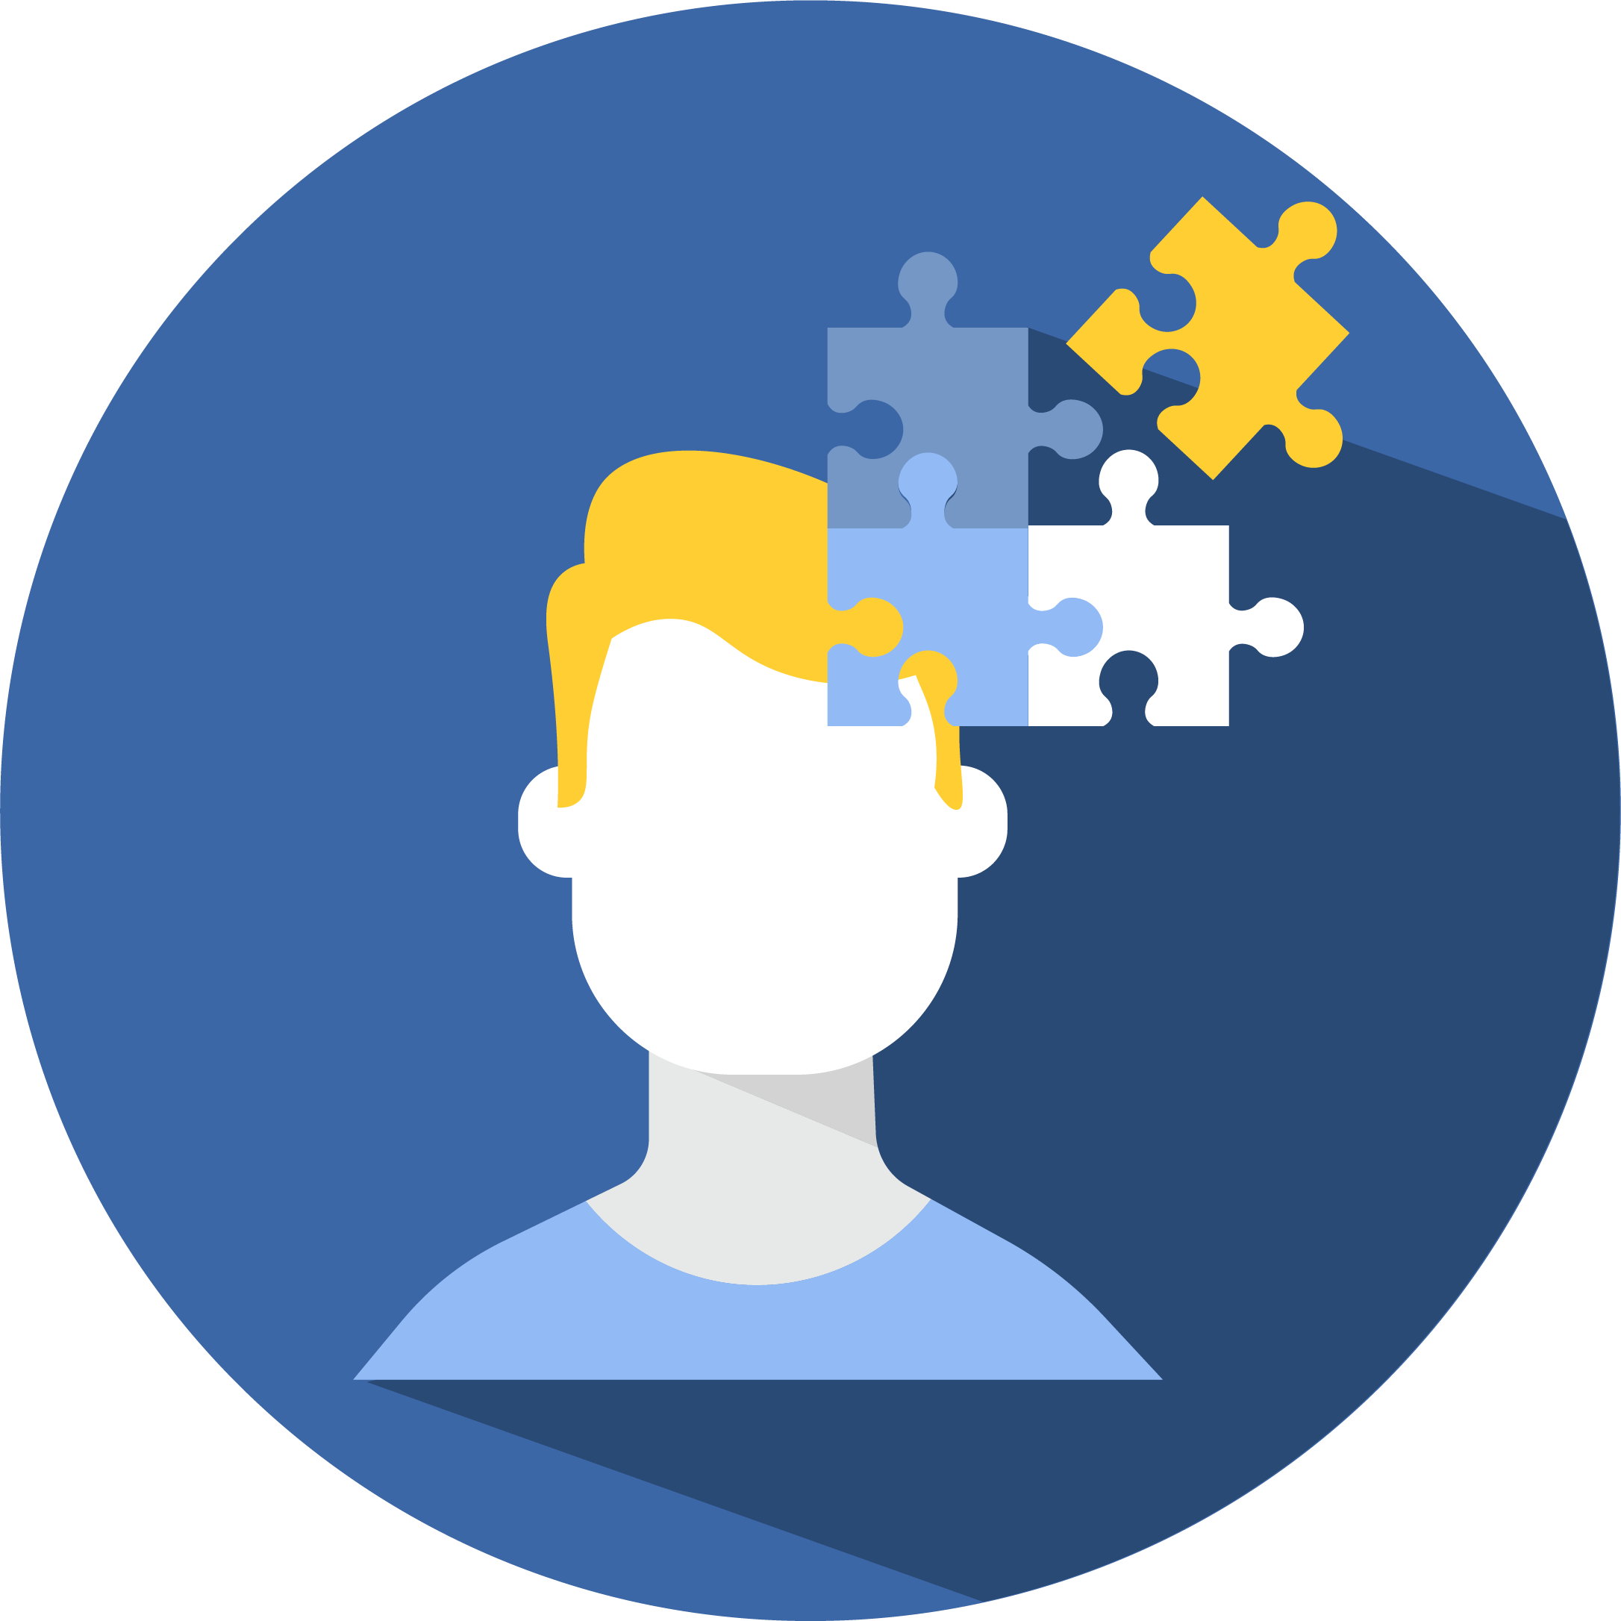
Problem Statement
51% of adults who felt stressed reported feeling depressed, and 61% reported feeling anxious.
Mental stress has become a widespread issue, affecting millions of people globally. The lack of awareness and timely intervention often leads to prolonged mental stress, impacting individuals' overall health and productivity.
The need for accessible and proactive mental health solutions has never been more critical.
Of the people who said they had felt stress at some point in their lives, 16% had self-harmed, and 32% said they had had suicidal thoughts and feelings.
37% of adults who reported feeling stressed reported feeling lonely as a result.

Slide 3
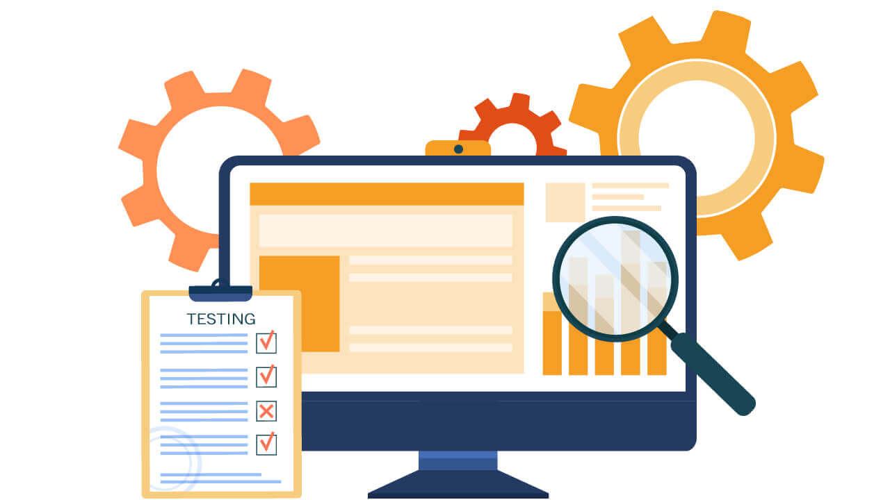

Key Features
Personalized Stress Level Detection
Each individual conducts the test himself to determine his stress, anxiety and depression levels which would enable personalized care and support.,
Access to Educational Modules
To handle and manage mild mental health related issues, our app empowers your with evidence-based learning modules covering various topics related to stress management and mental well-being.,

Slide 4

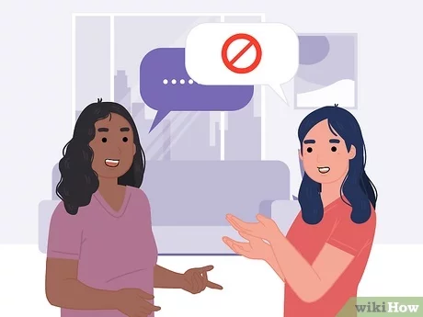
Key Features
Connect with Mental Health Professionals
Easily find and connect with qualified mental health doctors who can provide guidance and treatment options tailored to your needs.
Talk to Compassionate Volunteers
Compassionate Volunteers – Share your feelings and concerns with our supportive network of volunteers. Sometimes, a listening ear can make all the difference.

Slide 5
Approach
Research and Planning
Conduct thorough research on mental stress, symptoms, and relevant factors
Calculation of the stress, depression and anxiety levels based on the DASS-21 test.
Considering legal and ethical aspects related to mental health applications.
Application Development
Design an intuitive User Interface (UI) and User Experience (UX) with seamless integration of features so as to screen the individuals for depression, anxiety and stress
Conduction of the test.
Providing assistance to handle mental stress, depression and anxiety.
Collaboration
Collaborate with mental health organizations, professionals, or academic institutions to enhance credibility and reach
Enhancing the question set based on the regional and cultural aspects of people of a certain region with help from professionals.

Slide 6



Tech Stack
Android
Firebase - For authentication and data storage.
API's for navigation - to provide uninterrupted navigation
Intuitive User Interface
Animation, Gradient, style for interactive UI to offer a seamless and user-friendly experience.

Slide 7
THANK YOU
Our Team:
Name Branch Mentors
Shaurya Jain CSE(AI&ML) Garvit Singhal
Ayush Srivastava CSE(AI&ML) Sarthak Dubey
Dhruv Chaurasia CSE(AI&ML)
Nayni Singhal CSE(AI&ML)
Vedanshi Kaushik CSE(AI&ML)
Archit Agrawal CSE(AI&ML)

